Slide 1

Visual Media Compression
Yahya Bakkali

Slide 2
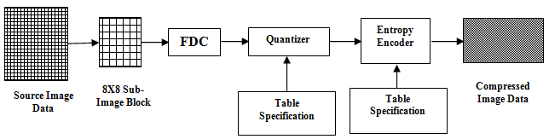
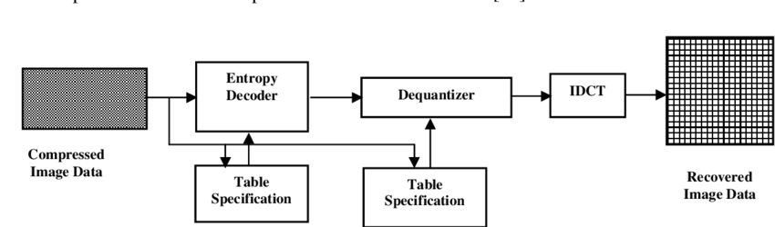
Image Codec
DCT
Zigzag scan
Encoder
Inverse Zigzag scan
Decoder
Source : https://www.researchgate.net/publication/276198827_A_New_Hybrid_JPEG_Symbol_Reduction_Image_Compression_Technique

Slide 3
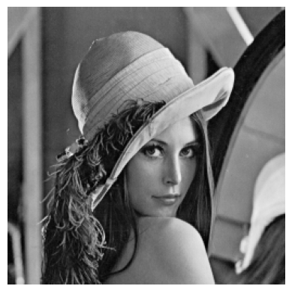
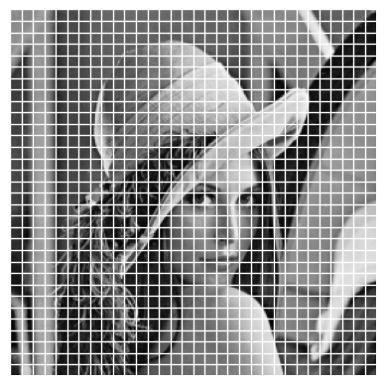
Encoder: Block-based coding
Source image
8x8 sub-image blocks

Slide 4
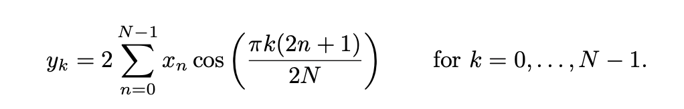
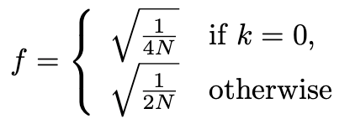
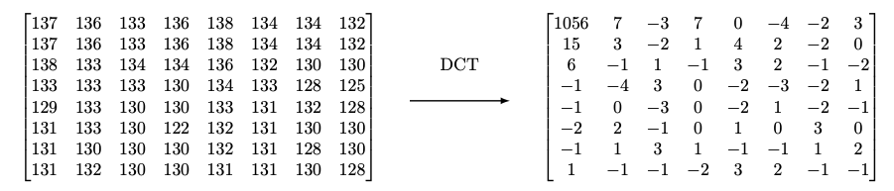
Encoder: DCT
DCT II
Normalization factor
DCT on Block 1
Source : https://docs.scipy.org/doc/scipy/reference/generated/scipy.fftpack.dct.html#scipy- fftpack- dct

Slide 5
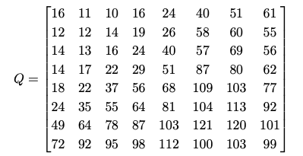
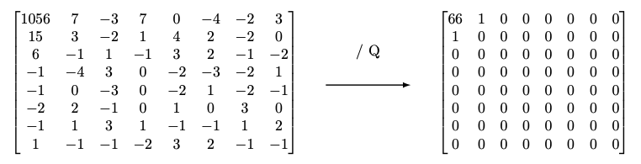
Encoder: Quantization
Quantization matrix
Quantization on block 1

Slide 6
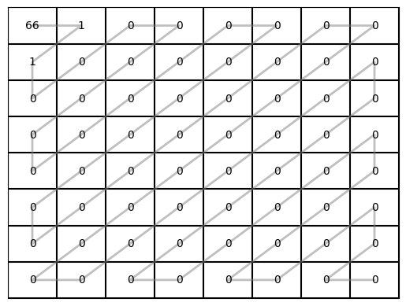
Encoder: Zigzag scan
Zigzag pattern
2D block 1 -> 1D
[66, 1, 1, EOB]

Slide 7
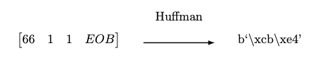
Encoder: Entropy Coding (Huffman)
Variable-length code on block 1
8 bits
8 bits
Hex -> binary
cbe4 -> 11001011 11|100|100
66
1
1

Slide 8
Decoder: Entropy Decoding & Inverse Zigzag scan
Lossless
Entropy decoding
Codebook
Inverse Zigzag
1D->2D
Add zeros

Slide 9
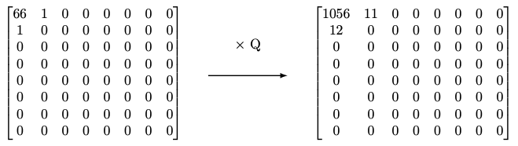
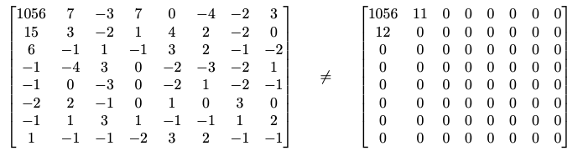
Decoder: Inverse Quantization
Dequantization of block 1
Lossy

Slide 10
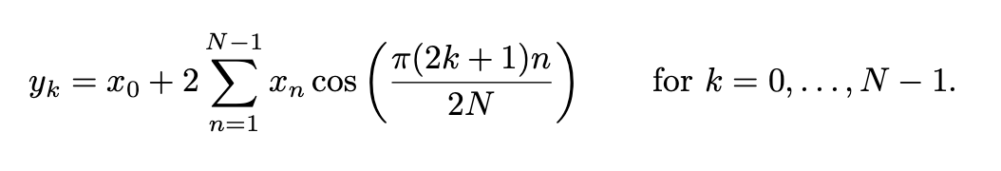
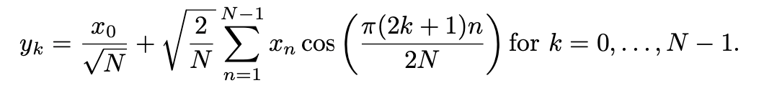
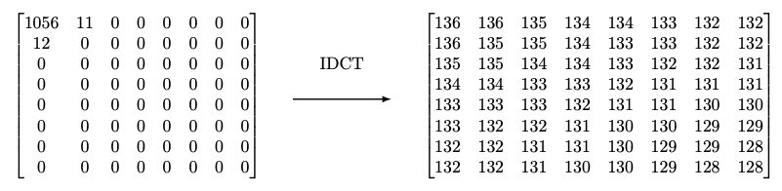
Decoder: Inverse DCT (IDCT)
IDCT II (DCT III)
Normalization fomrula
IDCT on Block 1
Source : https://docs.scipy.org/doc/scipy/reference/generated/scipy.fftpack.dct.html#scipy- fftpack- dct

Slide 11
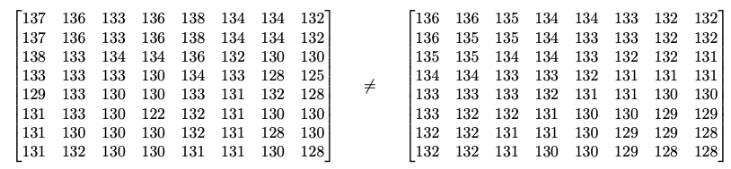
Decoder: Blocks Merge
Decoded image 1 block
Original
Compressed

Slide 12
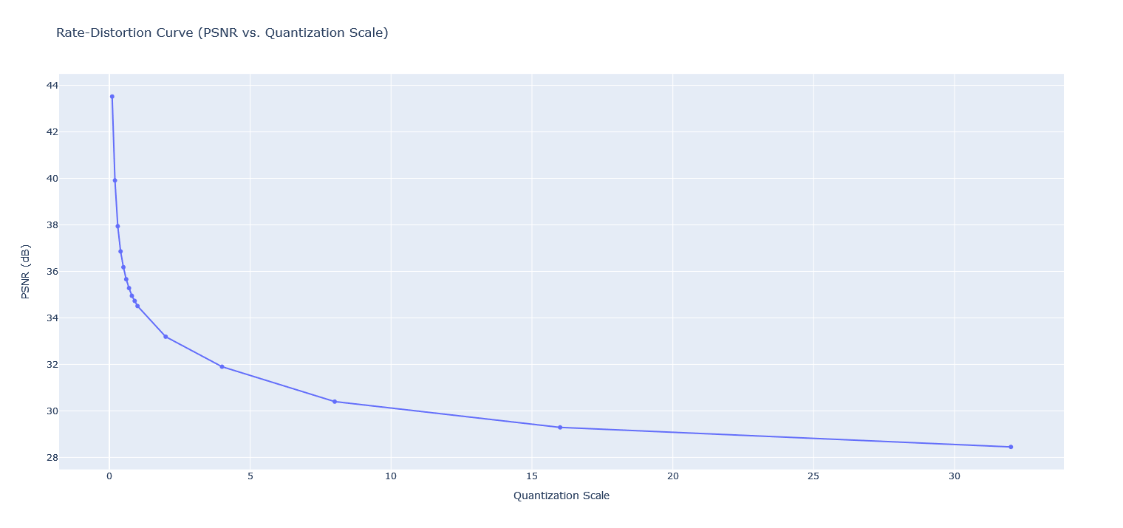
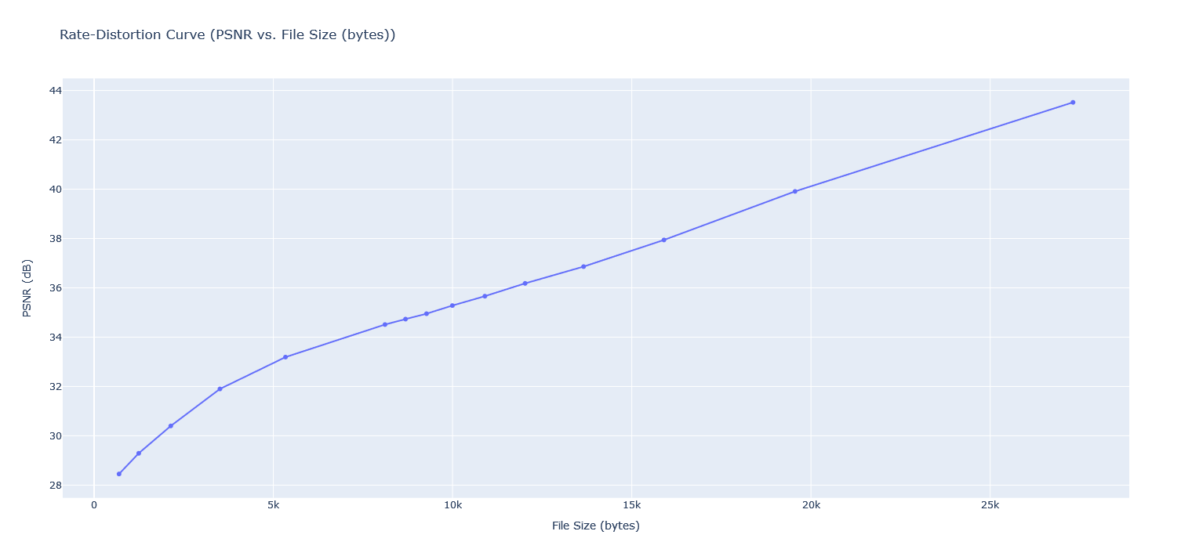
Evaluation: Rate-Distortion Curve
PSNR vs. Quantization scale
PSNR vs. File Size

Slide 13
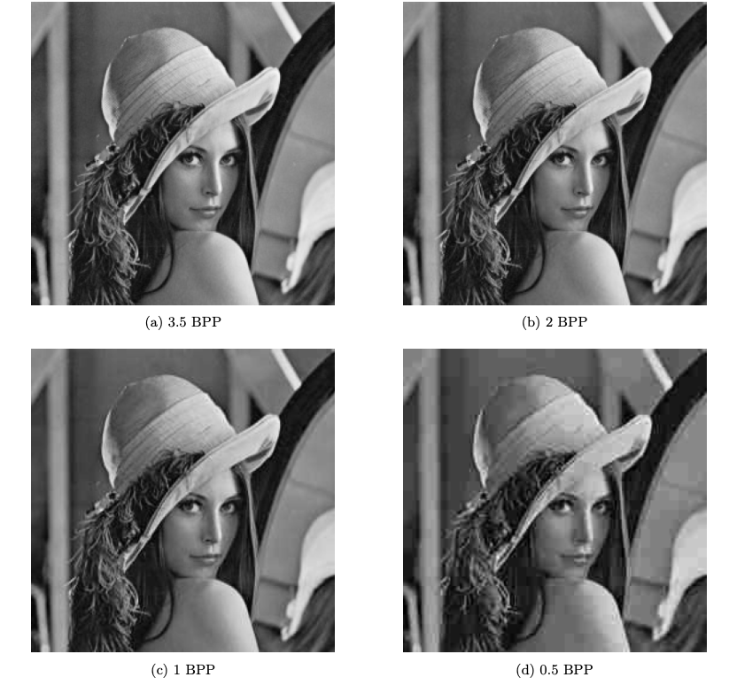
Evaluation: Subjective
Difference undetectable by human eyes between a, b and c
Good compression for 0.5 BPP

Slide 14
Video Codec (I-frames GOP)
Encoder
I-frame
I-frame
I-frame
I-frame
Zigzag scan
DCT
Compressed I-frame
I-frame
Decoder
I-frame
I-frame
Inverse Zigzag scan
I-frame
Compressed I-frame
Recovered
I-frame

Slide 15
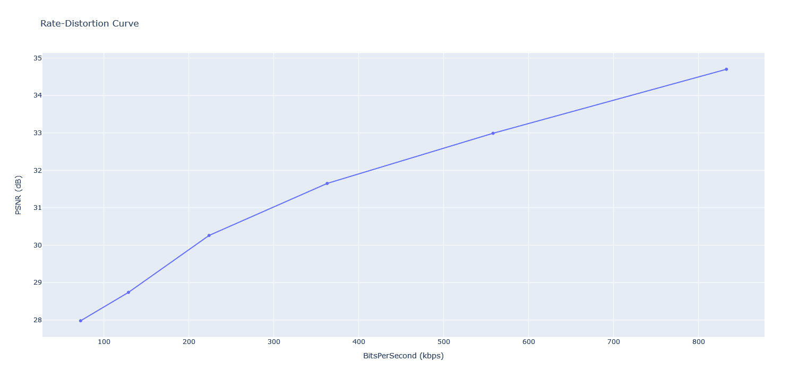
Evaluation: Rate-Distortion Curve
PSNR vs. BitsPerSecond

Slide 16
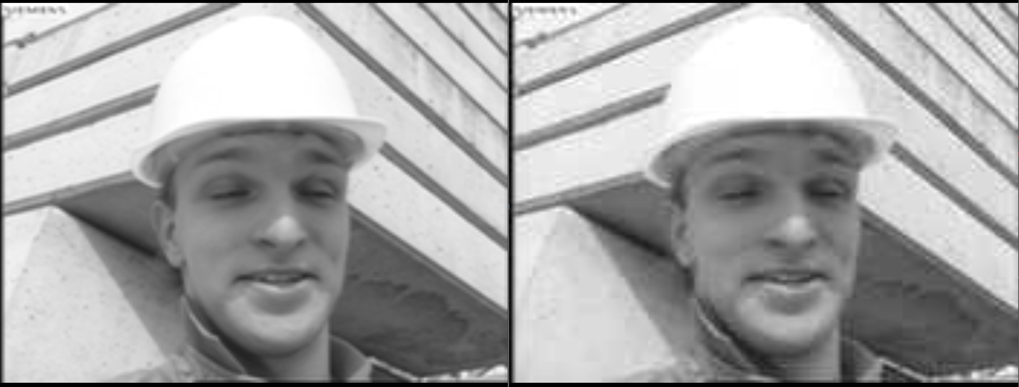
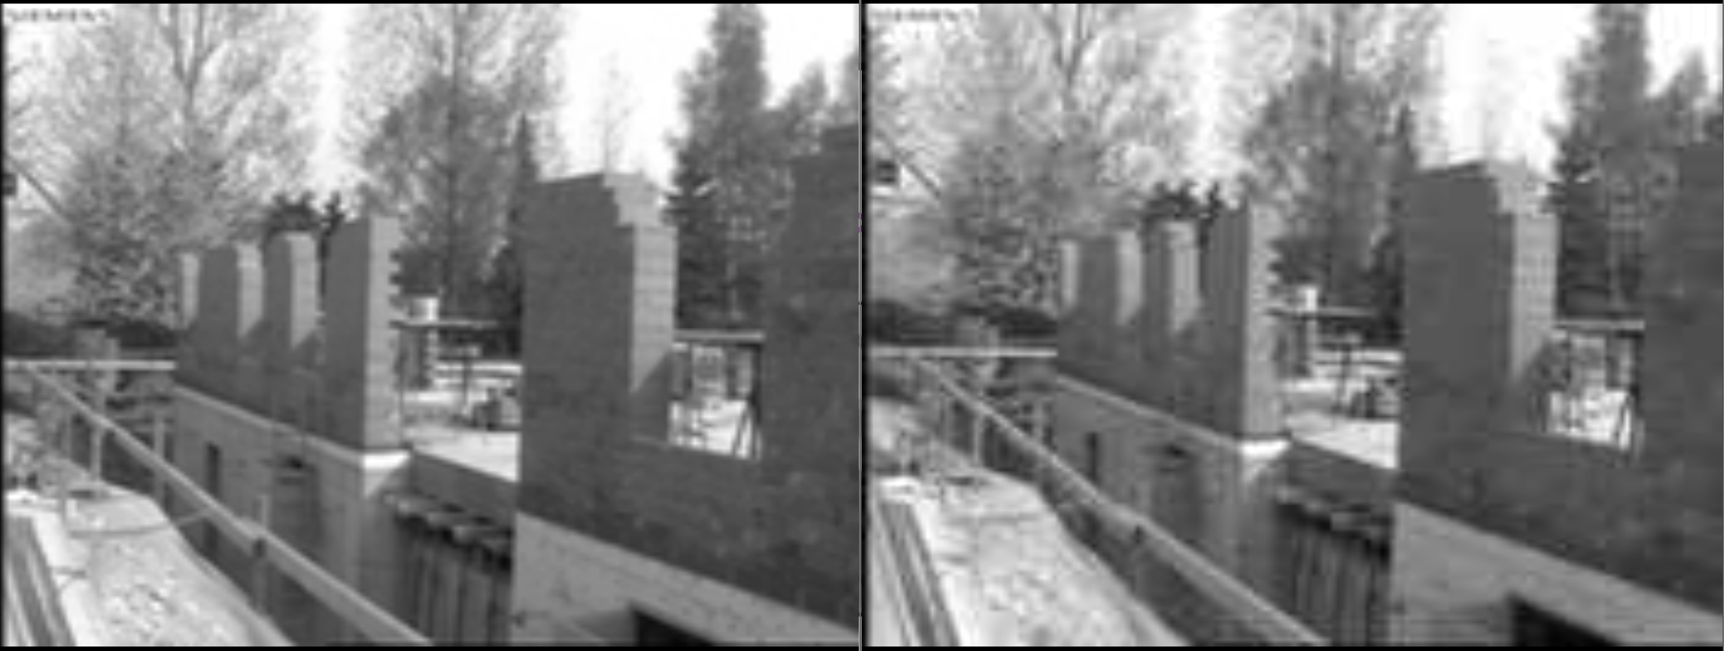
Evaluation: Subjective

Slide 17
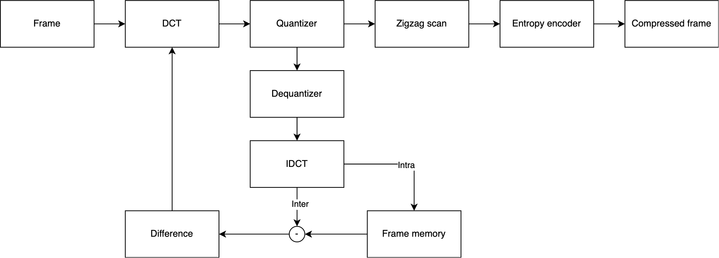
Video Codec (I-frames & D-frames GOP)
Encoder
I-frame
D-frame
D-frame
I-frame
D-frame
D-frame

Slide 18
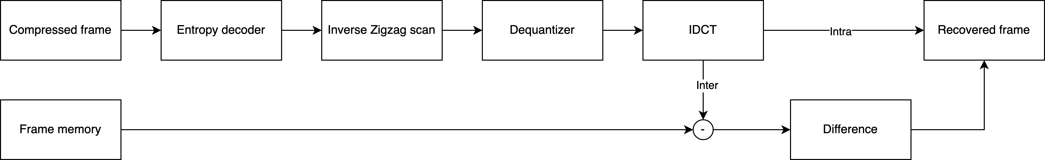
Video Codec (I-frames & D-frames GOP)
Decoder
I-frame
D-frame
D-frame
I-frame
D-frame
D-frame

Slide 19
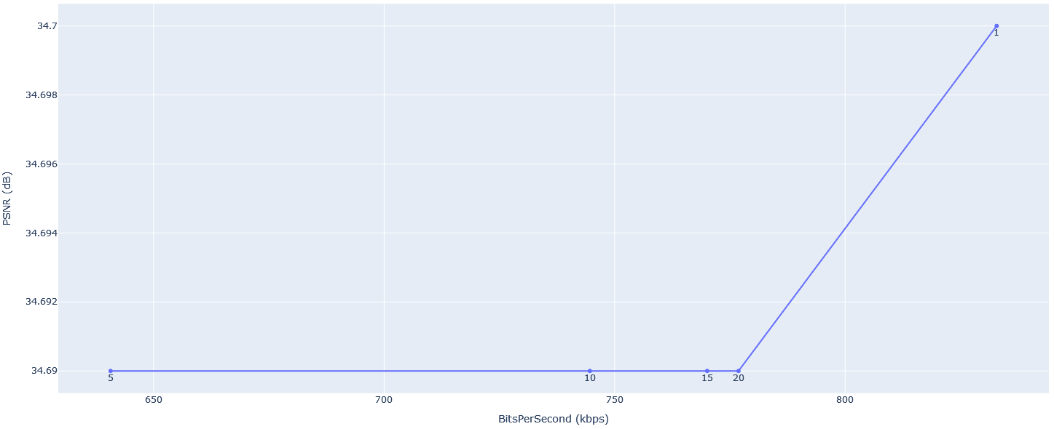
Evaluation: Rate-Distortion Curve
PSNR vs. BitsPerSecond for different GOP sizes

Slide 20
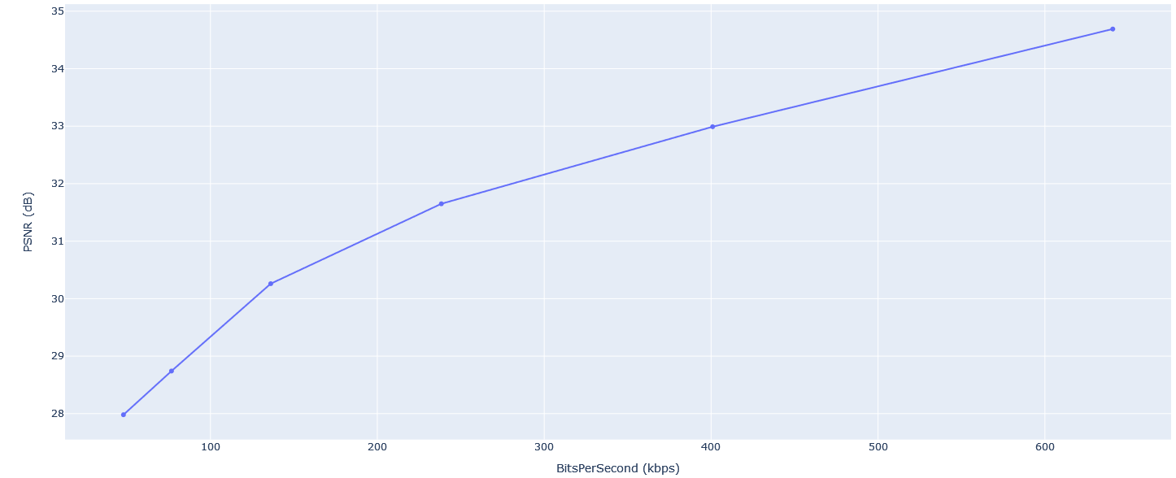
Evaluation: Rate-Distortion Curve of GOP 5
PSNR vs. BitsPerSecond

Slide 21

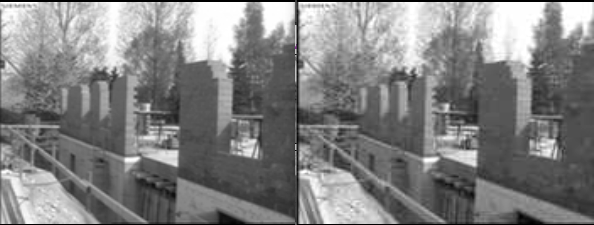
Evaluation: Subjective

Slide 22
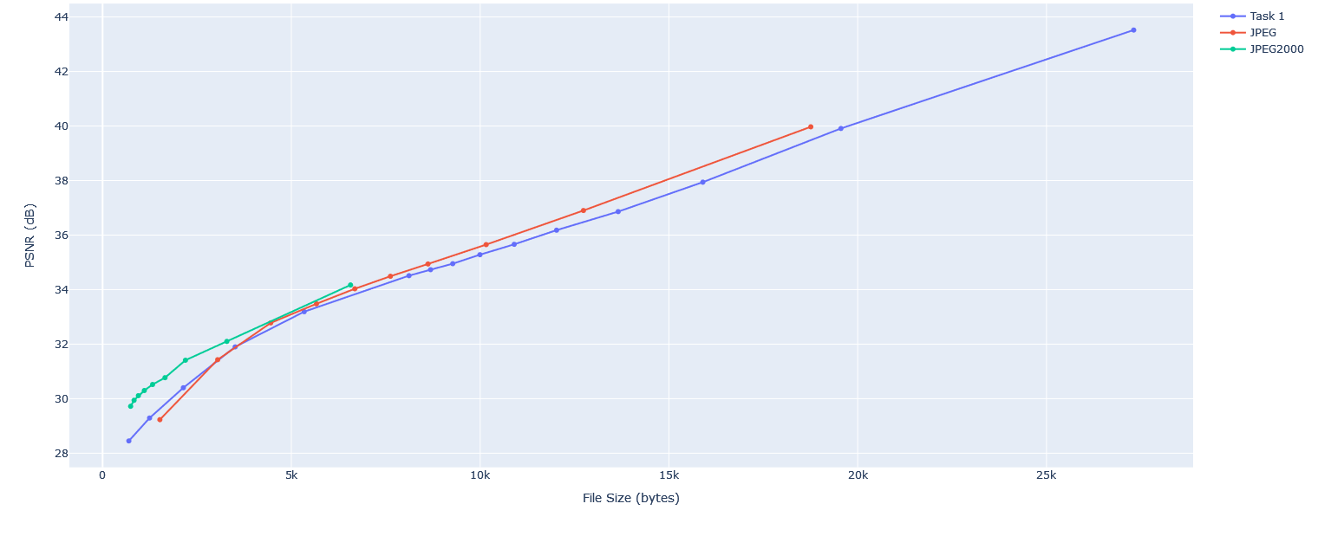
Image Codecs Evaluation
PSNR vs. File Size

Slide 23
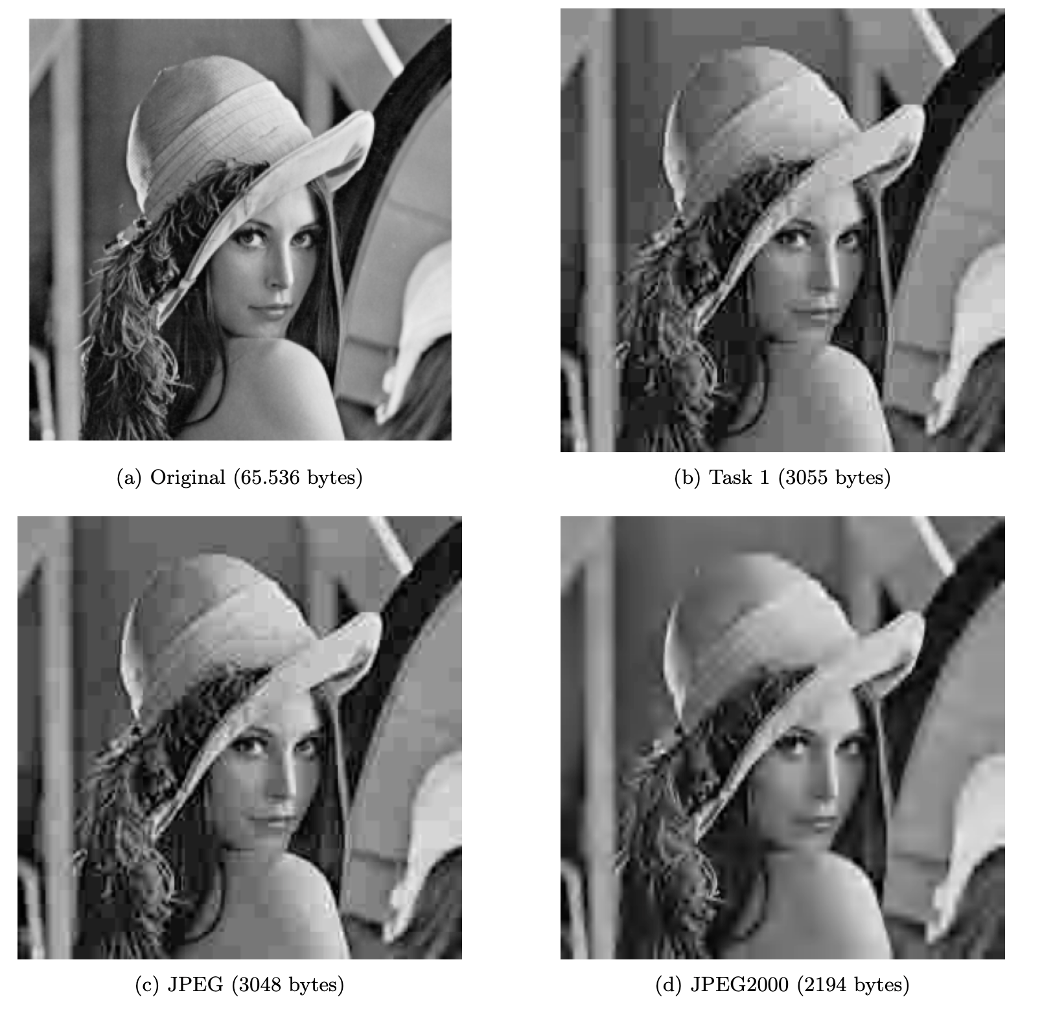
Image Codecs Evaluation

Slide 24
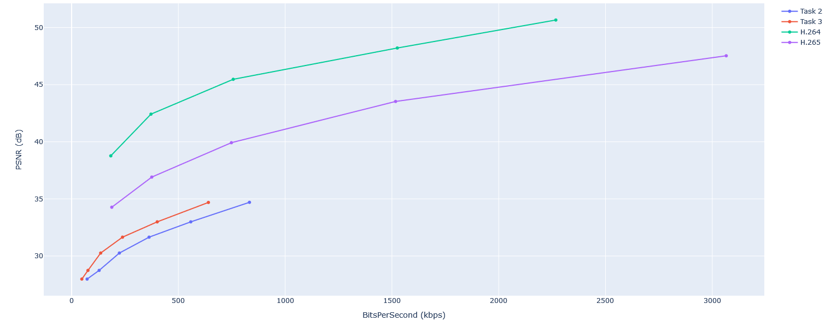
Video Codecs Evaluation
PSNR vs. BitsPerSecond

